Slide 1
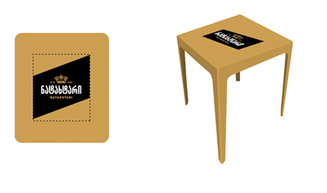
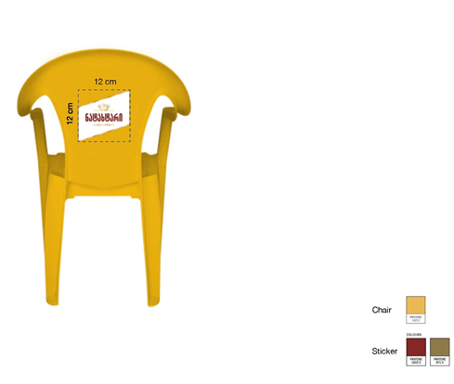
chair design is same as for table. we need to find better color for gold to fit the new logo colors

